Slide 1
Elastic Search

Slide 2
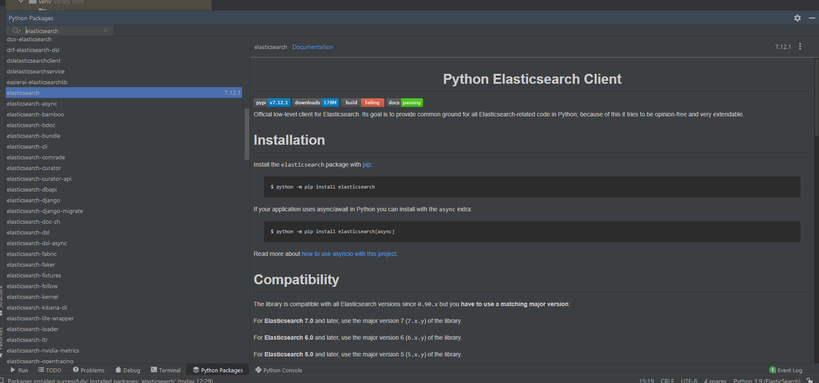
Elastic search client

Slide 3
Upload data file with postman
Post request to the following url http://localhost:9200/bank/account/_bulk?pretty
Add the file as binary
Content type in header must be application/json

Slide 4
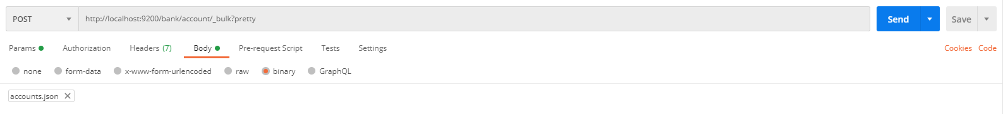
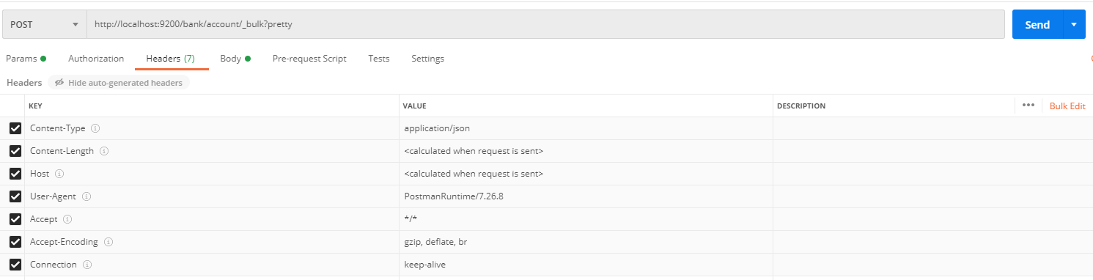
Upload data file with postman

Slide 5
Add new account
Post request to the following url: http://localhost:9200/bank/account/1001
Body- raw json:
{
"account_number":1001,
"balance":100000,
"firstname":"Jhon",
"lastname":"Smith",
"age":60,"gender":"M",
"address":"754 Dekoven Court",
"employer":"Geekfarm",
"email":"johns@geekfarm.com",
"city":"Brecon",
"state":"ME"
}
Content type in header must be application/json

Slide 6
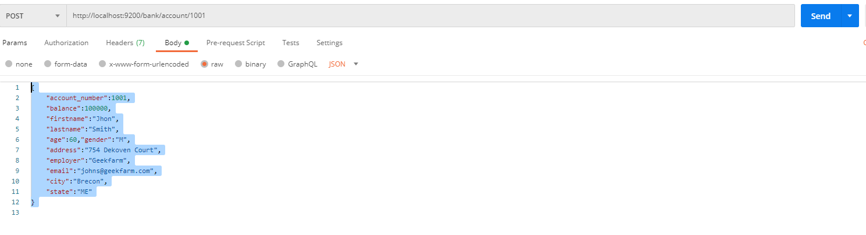
Add new account

Slide 7
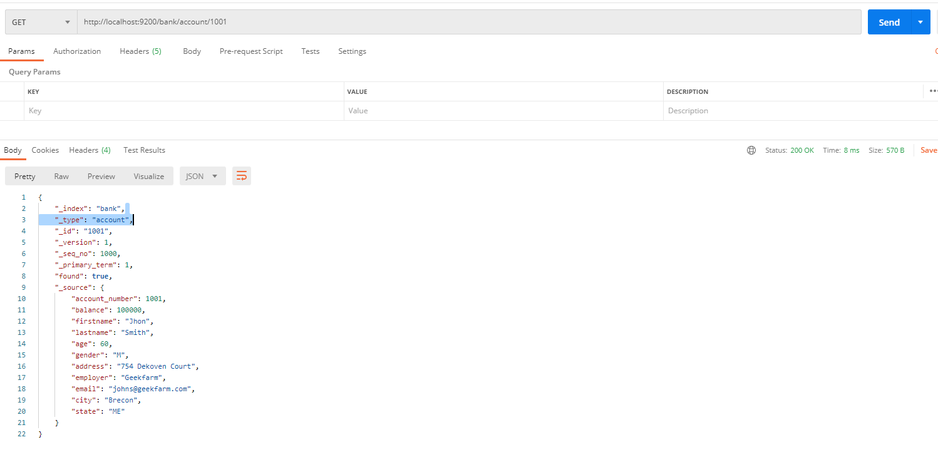
Get account
Get request to the following url: http://localhost:9200/bank/account/1001

